Slide 1
Shopeasy Application Deployment
From,
Anamika
Dayyala srilekha
Vaddagani aishwarya
Meghana s k

Slide 2
Objective
The objective of this project is to modernize application deployment by eliminating manual processes, introducing automation.
Problem Statement
The organization faced the following challenges:
Manual deployment process, which was time-consuming
No proper version control mechanism
Lack of automation in build and deployment
Higher chances of human errors

Slide 3
Solution Overview
To address these challenges, I implemented an end-to-end CI/CD pipeline using:
Flask → for application development
Docker → for containerization
GitHub → for version control
Google Cloud Build → for CI/CD automation
Artifact Registry → for storing Docker images
GKE (Kubernetes Engine) → for deployment

Slide 4
1. Application Development
Created a simple Flask-based web application
The app exposes an endpoint and runs on port 8080
2. Containerization
Created a Dockerfile to package the application
Built a Docker image and tested it locally
Ensured the application runs inside the container

Slide 5
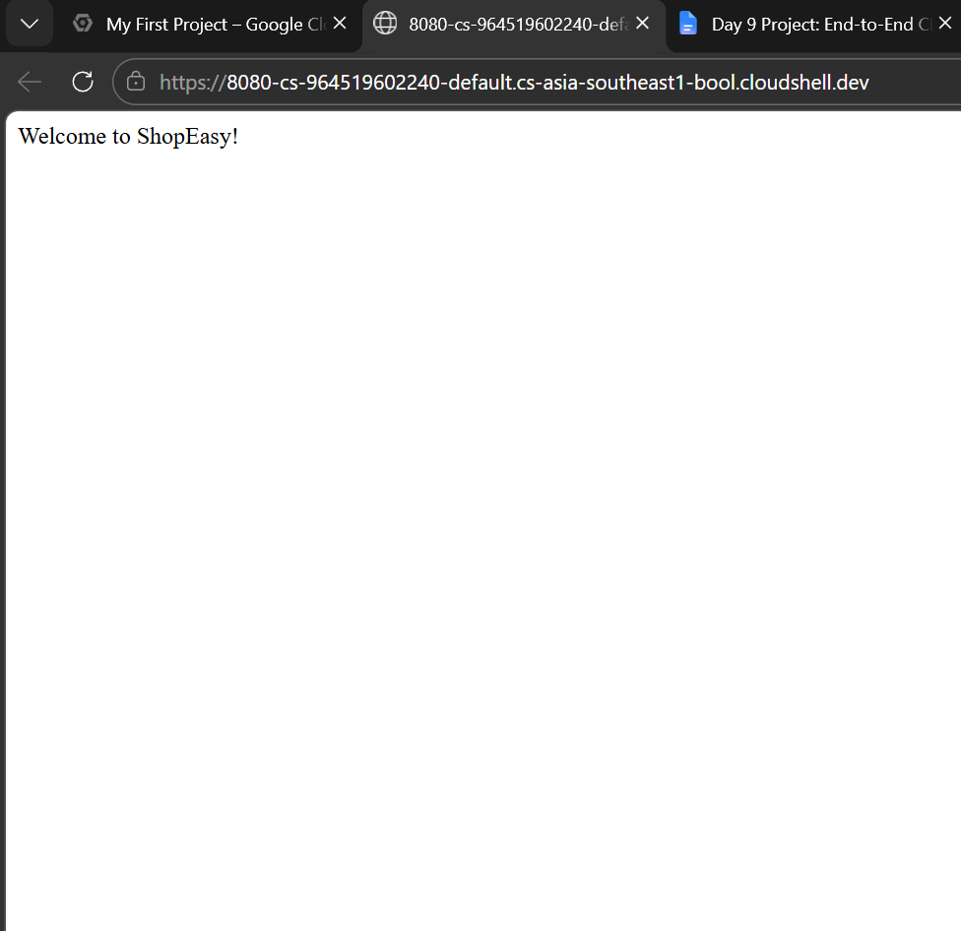
Output:

Slide 6
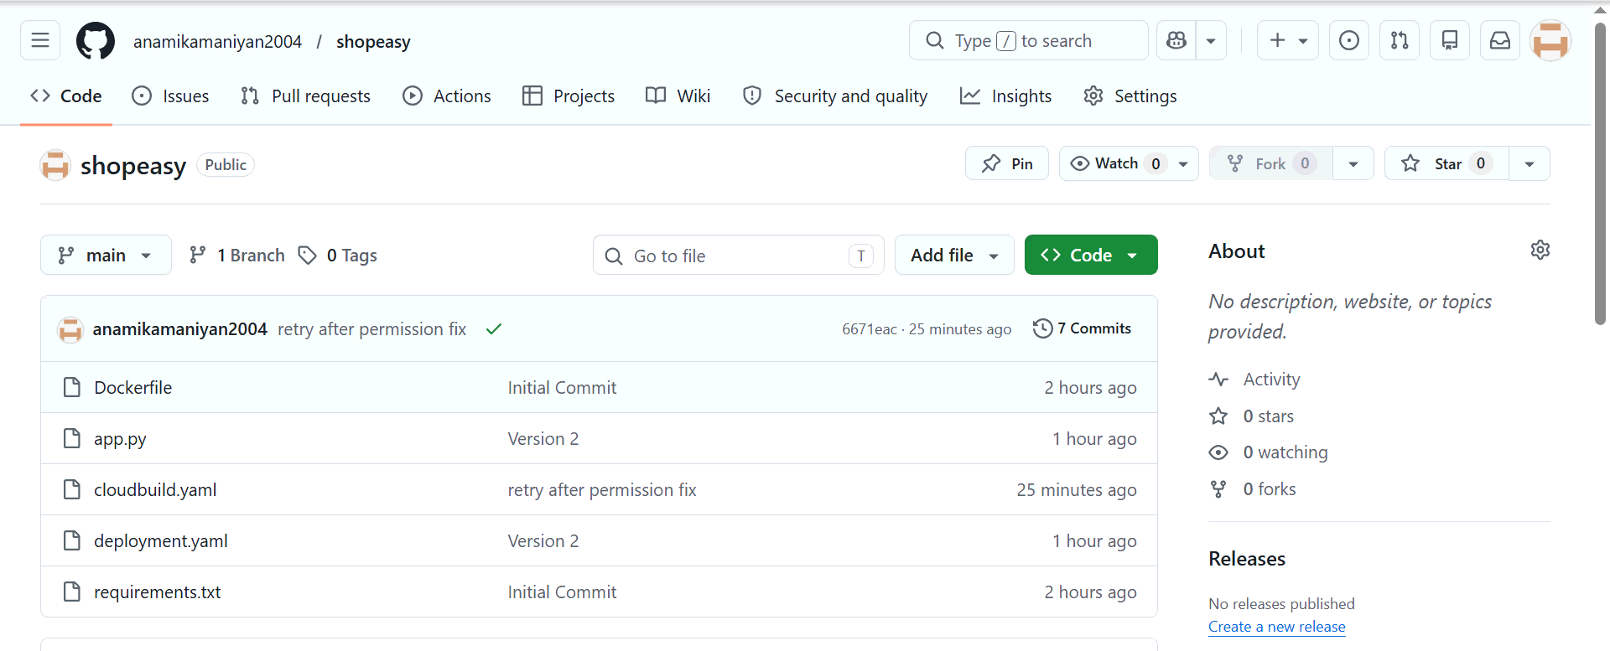
3.Version Control using GitHub
Initialized a Git repository
Pushed the application code to GitHub

Slide 7
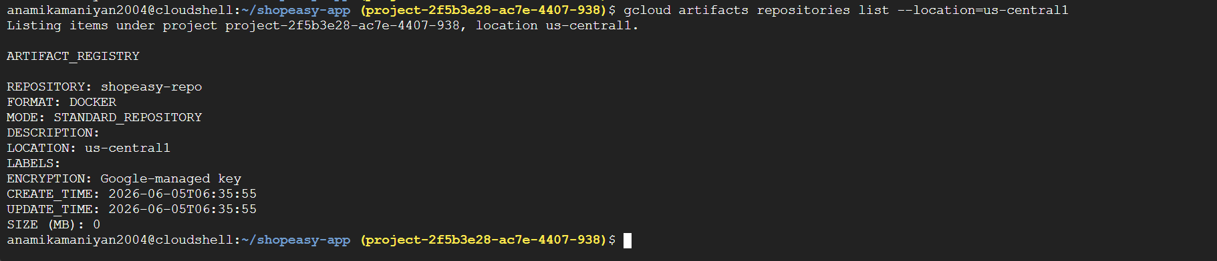
4. Create Artifact Registry​​
​​
Enable API​​
Create repo​

Slide 8
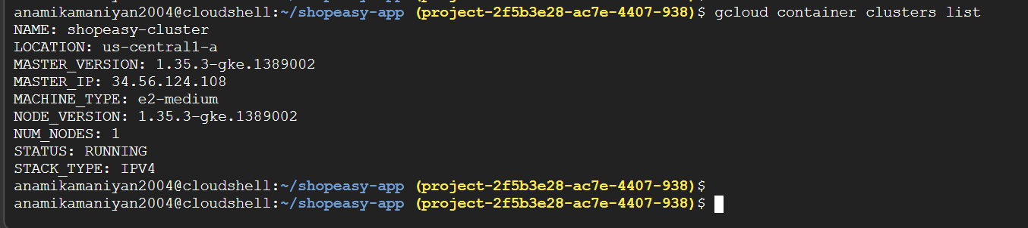
5. Creating GKE cluster

Slide 9
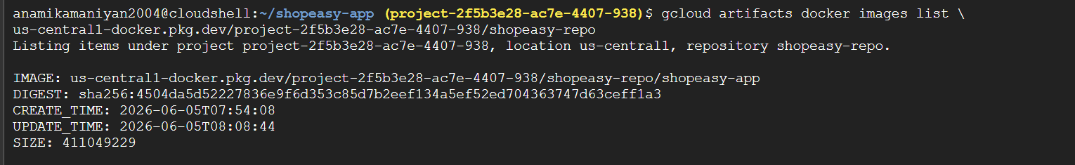
6.Build Image Using Cloud Build

Slide 10
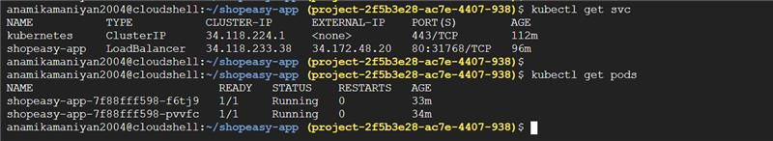
7.Deployment and Exposure of Application

Slide 11
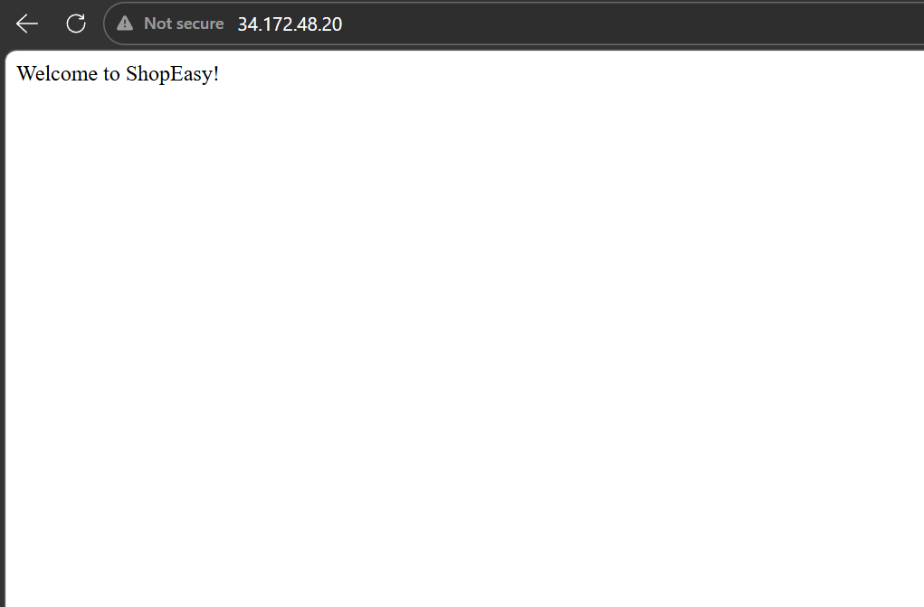
External IP:34.172.48.20

Slide 12
CI/CD Setup
Integrated GitHub with Cloud Build
Created Cloud Build trigger for automatic execution
Configured cloudbuild.yaml for build & deployment steps
Tested automated Docker image build and push

Slide 13
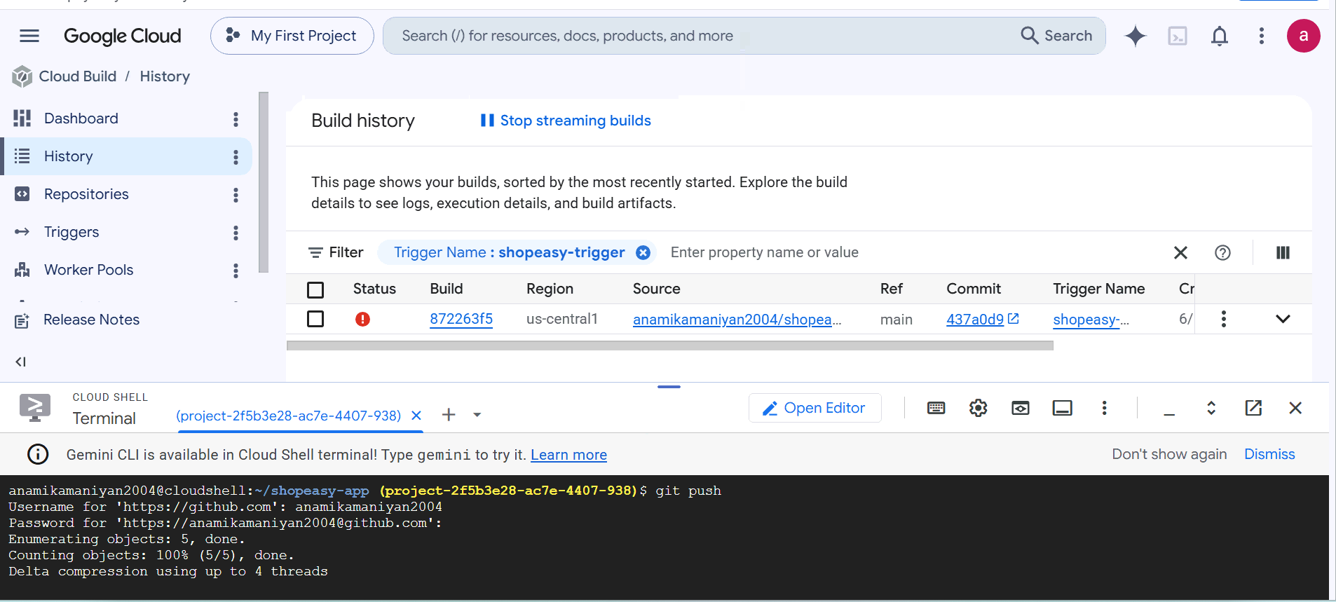

Slide 14
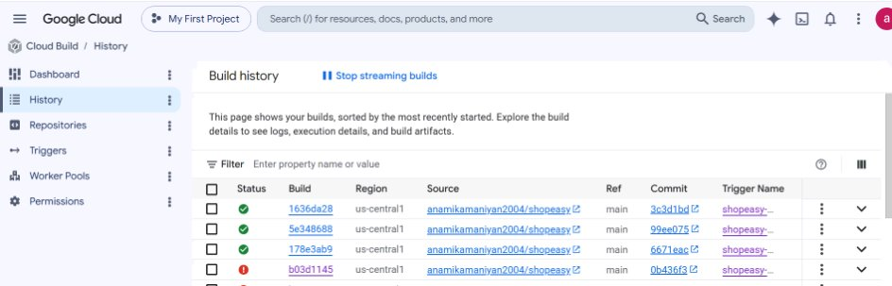
Output:

Slide 15
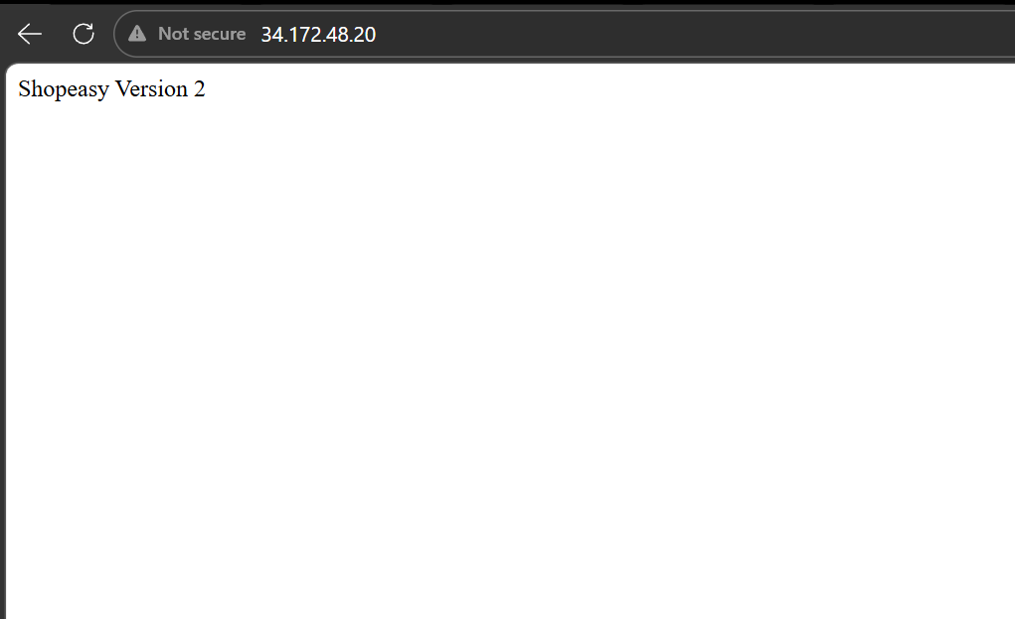

Slide 16
Chanllenges faced:
Trouble in managing correct ports (3000 vs 8080)
Got permission error in google build trigger while rebuilding
Command:
gcloud projects add-iam-policy-binding project-2f5b3e28-ac7e-4407-938 --member="serviceAccount:445502444750-compute@developer.gserviceaccount.com" --role="roles/container.admin"

Slide 17
Lesson learned:
Learned how to move from manual deployment to automated deployment
Understood the role of Artifact Registry in storing images
Trouble shoot real time errors.

